Slide 1
File Systems (2)
CS422/522 Lecture 11
15 October 2014
Last updated: 15 October 2014

Slide 2
Outline
Recap
File System Writes
Other Types of Files Systems
Wrap-Up

Slide 3
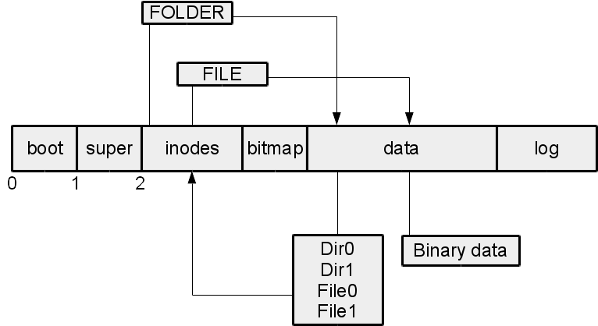
File System Overview

Slide 4
Reading from a FS
Find the inode in the inode cache or find a free inode
If a free inode:
  Find the buffer in the buffer cache or find a free buffer
  Read the buffer if necessary
  Update the inodes contents
  Release the buffer
Map the read address into the disk using inode maps
Find existing buffer or read from disk into a free buffer cache

Slide 5
Inode Cache
We store each inode in a cache
File descriptor has pointer to inode
Inode has reference counter
Freed back to inode cache upon end of use
Inodes are first loaded into memory via the buffer cache
Contents written to disk
Updated on disk if:
  Size increased during write
  No more active uses
  Contents deleted (truncated)

Slide 6
Buffer Cache
Stores all reads (and writes) from disk
Cannot be used concurrently
Sleep on block, but must check block again upon wakeup
Contents written to disk during a transaction commit

Slide 7
Outline
Recap
File System Writes
Other Types of Files Systems
Wrap-Up

Slide 8
File System Logs
Transactions
Series of writes
Atomic -- all or none
Prevents stale file system state, despite crashes
Supports batching

Slide 9
File System Logs in Action
Update a buffer cache
Set in-memory log to write to disk
Release for other readers / writers
...
Write log to on-disk log
Write log header to on-disk log header
Write content to disk data
Remove log header

Slide 10
Fault Tolerance
Empty log header:
Log header:
all committed or interrupted
interrupted before copying to data

Slide 11
Recovering from Log
Found non-empty log header
Read header
Store log contents into data
What happens to partially committed data

Slide 12
Xv6 Write Example
echo "Hello, World" > /home/davidiw/test
open("/home/davidiw/hw5.sol", O_CREAT | O_WRONLY)
Scan / inode for home ...
Find a free inode, create file shell
Update directory with new file entry
Return fd return to echo, echo perofms write(fd, ...)
Start a new transaction
Write (update) contents into 1 or more buffers
End transaction and queue it
Exit transcation - Write to disk log, then to disk, erase log

Slide 13
Creating a file
sys_open(void)
begin_op();
if(omode & O_CREATE){
ip = create(path, T_FILE, 0, 0);
...
if((f = filealloc()) == 0 || (fd = fdalloc(f)) < 0){ ... }
iunlock(ip);
end_op();
f−>type = FD_INODE;
f−>ip = ip;
f−>off = 0;
f−>readable = !(omode & O_WRONLY);
f−>writable = (omode & O_WRONLY) || (omode & O_RDWR);
return fd;

Slide 14
Inode and directory
create(char *path, short type, short major, short minor)
if((dp = nameiparent(path, name)) == 0)
return 0;
ilock(dp);
if((ip = ialloc(dp−>dev, type)) == 0)
panic("create: ialloc");
ilock(ip);
ip−>major = major;
ip−>minor = minor;
ip−>nlink = 1;
iupdate(ip);
if(dirlink(dp, name, ip−>inum) < 0)
panic("create: dirlink");
iunlockput(dp);
return ip;

Slide 15
Allocating an inode
ialloc(uint dev, short type)
readsb(dev, &sb);
for(inum = 1; inum < sb.ninodes; inum++){
bp = bread(dev, IBLOCK(inum));
dip = (struct dinode*)bp−>data + inum%IPB;
if(dip−>type == 0){ // a free inode
memset(dip, 0, sizeof(*dip));
dip−>type = type;
log_write(bp); // mark it allocated on the disk
brelse(bp);
return iget(dev, inum);
}
brelse(bp);
}

Slide 16
Updating a directory
dirlink(struct inode *dp, char *name, uint inum)
if((ip = dirlookup(dp, name, 0)) != 0){ ... }
for(off = 0; off < dp−>size; off += sizeof(de)){
if(readi(dp, (char*)&de, off, sizeof(de)) != sizeof(de))
panic("dirlink read");
if(de.inum == 0)
break;
}
strncpy(de.name, name, DIRSIZ);
de.inum = inum;
if(writei(dp, (char*)&de, off, sizeof(de)) != sizeof(de))
panic("dirlink");
return 0;

Slide 17
Writing data to an inode
writei(struct inode *ip, char *src, uint off, uint n)
for(tot=0; tot<n; tot+=m, off+=m, src+=m){
bp = bread(ip−>dev, bmap(ip, off/BSIZE));
m = min(n − tot, BSIZE − off%BSIZE);
memmove(bp−>data + off%BSIZE, src, m);
log_write(bp);
brelse(bp);
}
if(n > 0 && off > ip−>size){
ip−>size = off;
iupdate(ip);
}
return n;

Slide 18
Updating an inode
iupdate(struct inode *ip)
bp = bread(ip−>dev, IBLOCK(ip−>inum));
dip = (struct dinode*)bp−>data + ip−>inum%IPB;
dip−>type = ip−>type;
dip−>major = ip−>major;
dip−>minor = ip−>minor;
dip−>nlink = ip−>nlink;
dip−>size = ip−>size;
memmove(dip−>addrs, ip−>addrs, sizeof(ip−>addrs));
log_write(bp);
brelse(bp);

Slide 19
This whole notion of logging
We have not seen a bwrite
We have seen begin_op, log_write, end_op
These act as a logging layer to bwrite

Slide 20
Starting a transaction
begin_op(void)
acquire(&log.lock);
while(1){
if(log.committing){
sleep(&log, &log.lock);
} else if(log.lh.n + (log.outstanding+1)*MAXOPBLOCKS > LOGSIZE){
// this op might exhaust log space; wait for commit.
sleep(&log, &log.lock);
} else {
log.outstanding += 1;
release(&log.lock);
break;
}
}

Slide 21
Writing to the log
log_write(struct buf *b)
if (log.lh.n >= LOGSIZE || log.lh.n >= log.size − 1)
panic("too big a transaction");
if (log.outstanding < 1)
panic("log_write outside of trans");
for (i = 0; i < log.lh.n; i++) {
if (log.lh.sector[i] == b−>sector) // log absorbtion
break;
}
log.lh.sector[i] = b−>sector;
if (i == log.lh.n)
log.lh.n++;
b−>flags |= B_DIRTY; // prevent eviction

Slide 22
Ending the Transaction
end_op(void)
int do_commit = 0;
acquire(&log.lock);
if(--log.outstanding == 0){
do_commit = 1;
log.committing = 1;
} else {
wakeup(&log);
}
release(&log.lock);
if(do_commit){
commit();
acquire(&log.lock);
log.committing = 0;
wakeup(&log);
release(&log.lock);
}

Slide 23
Making a Commitment
commit()
if (log.lh.n > 0) {
write_log(); // Write modified blocks from cache to log
write_head(); // Write header to disk −− the real commit
install_trans(); // Now install writes to home locations
log.lh.n = 0;
write_head(); // Erase the transaction from the log
}

Slide 24
Writing the Log
write_log(void)
for (tail = 0; tail < log.lh.n; tail++) {
struct buf *to = bread(log.dev,
log.start+tail+1); // log block
struct buf *from = bread(log.dev,
log.lh.sector[tail]); // cache block
memmove(to−>data, from−>data, BSIZE);
bwrite(to); // write the log
brelse(from);
brelse(to);
}

Slide 25
Writing to the Disk
bwrite(struct buf *b)
if((b−>flags & B_BUSY) == 0)
panic("bwrite");
b−>flags |= B_DIRTY;
iderw(b);

Slide 26
Writing the Log Head
write_head(void)
struct buf *buf = bread(log.dev, log.start);
struct logheader *hb = (struct logheader *) (buf−>data);
int i;
hb−>n = log.lh.n;
for (i = 0; i < log.lh.n; i++) {
hb−>sector[i] = log.lh.sector[i];
}
bwrite(buf);
brelse(buf);

Slide 27
Completing the Transaction
install_trans(void)
int tail;
for (tail = 0; tail < log.lh.n; tail++) {
struct buf *lbuf = bread(log.dev,
log.start+tail+1); // read log block
struct buf *dbuf = bread(log.dev,
log.lh.sector[tail]); // read dst
memmove(dbuf−>data, lbuf−>data, BSIZE); // copy block to dst
bwrite(dbuf); // write dst to disk
brelse(lbuf);
brelse(dbuf);
}

Slide 28
Outline
Recap
File System Writes
Other Types of Files Systems
Wrap-Up

Slide 29
Other Types of Files Systems
Pipes
Devices (devfs)
System state: procfs, sysfs
Log / transaction
Database
Tape
Flash
Network file systems
FUSE

Slide 30
Devices
Character -- direct / unbuffered
Block -- indirect / buffered
/dev/null -- writes are discarded, nothing to read
/dev/zero -- writes are discarded, reads return NUL
/dev/full -- unable to write, returns NUL
/dev/random | /dev/urandom -- pseudo-random streams
/dev/sda | /dev/hda -- hard disks

Slide 31
procfs
Found under /proc
Process information /proc/$PID
OS information
Uptime
Network settings
Set -- echo $VALUE > file
Read -- cat file

Slide 32
sysfs
Similar to procfs / devfs
Emphasis on unified driver / device
Change brightness on a laptop display:
cat /sys/class/backlight/intel_backlight/max_brightness > /sys/class/backlight/intel_backlight/brightness

Slide 33
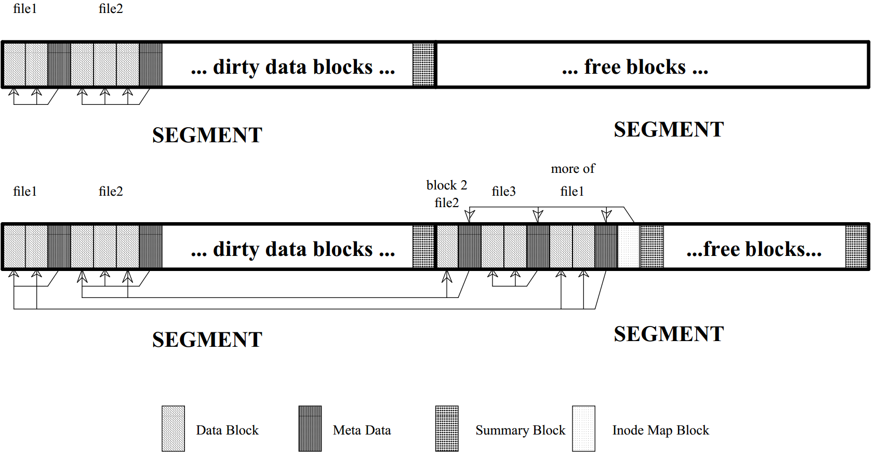
Transactional File System
Log in xv6 offers:
Never overwrite contents, requires garbage collection
All writes should be written sequentially, like xv6 log
Many writes can be issued together -- transaction
atomic writes

Slide 34
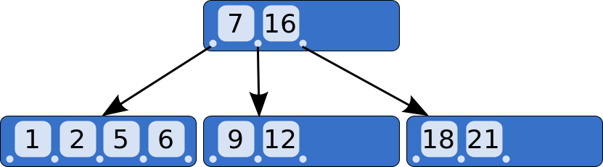
Database
Relational -- contents can easily be found by query -- not path
What happens if we insert or delete content from the middle of a file?
entire file must be updated from that point on
Databases can store large objects using B-tree:
b-tree contains meta-data including offset and size
data is variable size

Slide 35
Tape
Why tapes?
  inherently hot-swappable
  cooler
  rugged
  fast sequential writes
  Two approaches:
Two approaches:
  Meta-data at head, data afterward
  Meta-data interspersed with data

Slide 36
Flash
Challenges / Features not addressed by existing FS:
  Blocks must be explicitly erased before written -- takes time
  Supports random access
  Wear leveling -- rewriting same block can wear out block
Log structured file systems
Hardware vs software support erasing blocks / wear leveling

Slide 37
Network File Systems
Share folder / files across Network
Benefits:
Deduplication of dat
  Deduplication of data
  Shared home directories
  Convenient access to common files
Challenges:
  Access permissions
  Where to store state
  Coherency

Slide 38
FUSE
File-System in User-Space
Operations occur in a virtual file system
Redirected toward user-space handler
Able to write fully functional FS: NTFS, SSHFS

Slide 39
Outline
Recap
File System Writes
Other Types of Files Systems
Wrap-Up

Slide 40
Lab
Lab 4 due tomorrow
Lab 5 assigned, due 30 October

Slide 41
Next Time
I/O, Drivers, and Exam prep
Monday 1:00PM

